Slide 1
Job portal database management system
m.sreeya.
B.Harika.
v.sai Charan.

Slide 2
introduction
The Job Portal Database Management System is a relational database developed using MySQL to simplify the recruitment process.
It stores and manages information about candidates, companies, jobs, skills, applications, and interviews.
Candidates can search and apply for jobs, while companies can post vacancies and manage applicants.
The database also helps generate recruitment reports and hiring statistics for better decision-making.

Slide 3
Project objectives
Organize recruitment data using a relational database.
Store candidate and company information efficiently.
Manage job postings and applications.
Track interview schedules and results.
Maintain data integrity using Primary Keys and Foreign Keys.
Generate reports using SQL queries and aggregate functions.

Slide 4
modules
Candidates.
Companies.
Jobs.
Skills.
Applications.
Interviews.

Slide 5
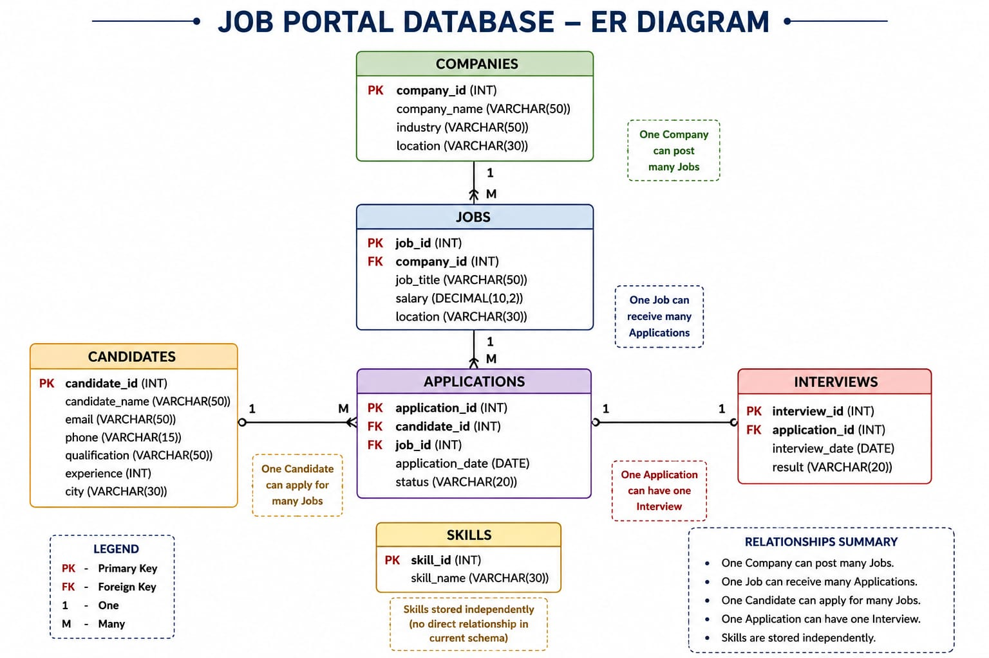
Er diagram

Slide 6
Database relationships
One company can post multiple jobs.
One job belongs to one company.
One candidate can apply for multiple jobs.
One application belongs to one candidate and one job.
One application can have one interview.
Skills are stored separately to maintain technical skill information.

Slide 7
Example queries
Example Query 1 – Candidate Application Details
SELECT c.candidate_name, j.job_title, a.status FROM Candidates c JOIN Applications a ON c.candidate_id = a.candidate_id JOIN Jobs j ON a.job_id = j.job_id;
Example Query 2 – Hiring Statistics
SELECT status, COUNT(*) AS Total Applications FROM Applications GROUP BY status;

Slide 8
CONCLUSION
The Job Portal Database Management System provides an efficient way to manage recruitment activities. It stores candidates, companies, jobs, applications, and interviews in a structured relational database.Using MySQL concepts such as Primary Keys, Foreign Keys, Joins, Aggregate Functions, Subqueries, and Views, the project demonstrates how relational databases can automate recruitment and generate meaningful hiring reports.

Slide 9
thank you

